Slide 1
OPTIMIZING SAFETY DRIVEN
NAVIGATION AID FOR VISUALLY IMPAIRED
Batch No: 05
Team Members:
Agalya K (211521205008)
A S Sai Sruthi (211521205014)
Anbarasi K (211521205015)
Guided By:
Dr.G.Dhanalakshmi, M.E.,Ph.D
Head Of The Department
Department of Information Technology
Panimalar Institute Of Technology

Slide 2
Abstract
In recent times, urban navigation has become more challenging for visually impaired individuals who lack awareness of obstacles around them, making independent movement difficult. To address this, we propose a smart obstacle detection and navigation system designed to enhance mobility and safety.
This system employs sensors strategically placed to cover four directions, allowing real-time identification of obstacles within the user's vicinity. When an obstacle is detected, an alert is triggered through a buzzer, and the system provides audio guidance to navigate towards a safer, obstacle-free path.
By using advanced audio instructions, users can move confidently in unfamiliar environments. The device's compact and wearable design makes it convenient for daily use, encouraging visually impaired individuals to explore the city independently while minimizing the risk of collisions. This solution not only increases accessibility but also fosters a sense of autonomy, enabling users to navigate public spaces safely and confidently.

Slide 3
Introduction
Visually impaired individuals face difficulties navigating urban areas due to limited spatial awareness and obstacle detection .Traditional aids like white canes and guide dogs have limitations in range and adaptability .The Smart Obstacle Detection and Navigation System uses sensors, microcontrollers, and audio feedback for real-time guidance.It includes ultrasonic sensors, an Arduino board, a buzzer, and a speaker to detect obstacles and provide alerts .The system guides users using voice prompts and alerts them immediately with a buzzer .Compact and wearable, the device enhances mobility and independence in daily life .It offers an affordable, practical solution that promotes confidence and social inclusion for the visually impaired.

Slide 4
Existing System
Traditionally, visually impaired individuals rely on white canes to detect obstacles, but these require physical contact and offer limited information about distant objects. Guide dogs provide a higher level of assistance by helping users navigate around obstacles however, they are expensive, require extensive training, and may struggle in complex urban environments. GPS-based applications can offer directional guidance, yet they fall short in detecting immediate physical obstacles. Overall, these existing systems lack the ability to ensure real-time safety and do not provide instant feedback about the surrounding environment an essential requirement for visually impaired individuals to navigate independently and securely.

Slide 5
Proposed System
Real-Time Obstacle Detection The system uses sensors to detect obstacles in four directions, providing immediate alerts to the user, ensuring proactive awareness of the surroundings.
Audio Navigation Guidance Users receive audio cues to safely navigate toward open spaces, enhancing mobility and reducing dependency on physical contact with obstacles.
Affordable and Compact Design The lightweight, wearable device offers cost-effective, hands-free assistance, enabling visually impaired individuals to explore public spaces independently and confidently.

Slide 6
Literature Survey
S. No | Year | Title | Author | Methodology | Merits | Demerits
1. | 2021 | IoT-Based Smart Walking Stick for the Visually Impaired | A. Sharma, P. Verma, et al. | Uses ultrasonic sensors and Arduino to detect obstacles and alert users via buzzer and vibration. | Uses ultrasonic sensors to detect obstacles and alert the user through vibrations and audio feedback. | Limited detection range and may not be effective in detecting fast-moving objects.
2. | 2022 | AI-Powered Wearable Navigation Aid for Blind People | A. Sharma, P. Verma, et al. | Uses a wearable camera with AI and cloud processing to recognize objects and guide users with audio feedback. | Integrates AI-based object recognition for real-time path guidance and enhanced obstacle detection. | High computational cost and requires a stable internet connection for cloud processing

Slide 7
System Requirements
Hardware Requirements
ULTRASONIC SENSOR
DF PLAYER
SPEAKER
BUZZER
POWER SUPPLY
AURDINO UNO
Software Requirements
ARDUINO IDE
EMBEDDED C

Slide 8
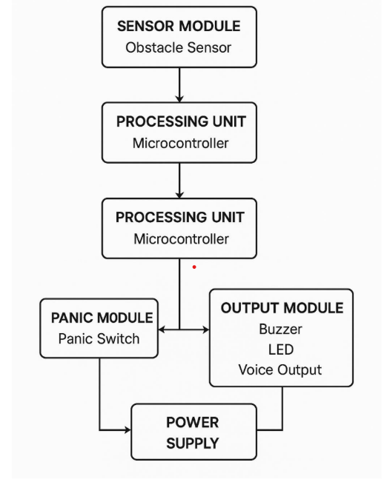
System Architecture

Slide 9
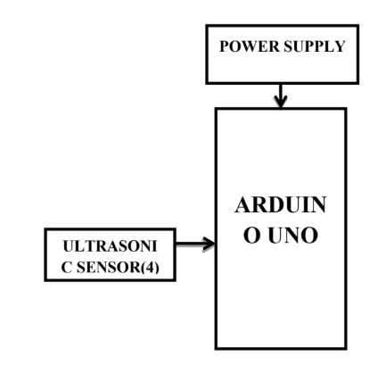
Module 1
Module 1: Object Detection Module Objective:
Detects obstacles using ultrasonic sensors placed in four directions.
Sends real-time data to Arduino Uno for processing.
Identifies the safest direction for movement and avoids collisions.
Triggers a buzzer alert when an obstacle is detected.
Enhances navigation safety for visually impaired individuals

Slide 10
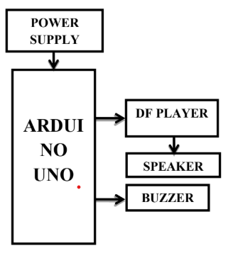
Module 2
Module 2: Alert Module
Generates real-time alerts when an obstacle is detected.
Uses a buzzer and speaker to provide audio warnings.
the user with voice instructions (e.g., "Turn left").
Ensures quick response to obstacles for safe navigation.
Enhances situational awareness without requiring visual input

Slide 11
Module 3
POWER SUPPLY
Module 3: Power Management Module
Supplies stable power to all hardware components.
Uses a rechargeable battery with optimized energy usage.
Prevents overcharging with a power regulation circuit.
Monitors battery status and alerts the user for recharging.
Ensures uninterrupted operation for reliable navigation
ARDUINO UNO
DF PLAYER
ULTRASONIC SENSOR(4)
SPEAKER
BUZZER
I2C & LCD

Slide 12
Source Code
// Include necessary libraries
#include <SoftwareSerial.h>
#include <DFRobotDFPlayerMini.h>
// Define pins for ultrasonic sensors
#define TRIG_FRONT 2
#define ECHO_FRONT 3
#define TRIG_LEFT 4
#define ECHO_LEFT 5
#define TRIG_RIGHT 6
#define ECHO_RIGHT 7
// Define buzzer and speaker pins
#define BUZZER 8
#define SPEAKER_TX 10
#define SPEAKER_RX 11

Slide 13
// Initialize serial communication for the DFPlayer Mini MP3 module
SoftwareSerial mySerial(SPEAKER_RX, SPEAKER_TX);
DFRobotDFPlayerMini player;
// Function to measure distance using ultrasonic sensor
int getDistance(int trigPin, int echoPin) {
digitalWrite(trigPin, LOW);
delayMicroseconds(2);
digitalWrite(trigPin, HIGH);
delayMicroseconds(10);
digitalWrite(trigPin, LOW);
int duration = pulseIn(echoPin, HIGH);

Slide 14
int distance = duration * 0.034 / 2; // Convert to cm
return distance;
}
void setup() {
Serial.begin(9600);
mySerial.begin(9600);
// Initialize ultrasonic sensor pins
pinMode(TRIG_FRONT, OUTPUT);
pinMode(ECHO_FRONT, INPUT);
pinMode(TRIG_LEFT, OUTPUT);
pinMode(ECHO_LEFT, INPUT);
pinMode(TRIG_RIGHT, OUTPUT);

Slide 15
pinMode(ECHO_RIGHT, INPUT);
// Initialize buzzer
pinMode(BUZZER, OUTPUT);
// Initialize speaker module
if (!player.begin(mySerial)) {
Serial.println("DFPlayer Mini not detected!");
while (true);
}
player.volume(25); // Set volume level
}
void loop() {

Slide 16
int frontDistance = getDistance(TRIG_FRONT, ECHO_FRONT);
int leftDistance = getDistance(TRIG_LEFT, ECHO_LEFT);
int rightDistance = getDistance(TRIG_RIGHT, ECHO_RIGHT);
Serial.print("Front: "); Serial.print(frontDistance); Serial.print(" cm ");
Serial.print("Left: "); Serial.print(leftDistance); Serial.print(" cm ");
Serial.print("Right: "); Serial.print(rightDistance); Serial.println(" cm");
delay(500); // Small delay before next scan
}

Slide 17
if (frontDistance < 30) {
digitalWrite(BUZZER, HIGH);
player.play(1); // Play "Obstacle ahead" audio
delay(1000);
digitalWrite(BUZZER, LOW);
} else if (leftDistance < 30) {
digitalWrite(BUZZER, HIGH);
player.play(2); // Play "Turn right" audio
delay(1000);

Slide 18
digitalWrite(BUZZER, LOW);
} else if (rightDistance < 30) {
digitalWrite(BUZZER, HIGH);
player.play(3); // Play "Turn left" audio
delay(1000);
digitalWrite(BUZZER, LOW);
}

Slide 19
int frontDistance = getDistance(TRIG_FRONT, ECHO_FRONT);
int leftDistance = getDistance(TRIG_LEFT, ECHO_LEFT);
int rightDistance = getDistance(TRIG_RIGHT, ECHO_RIGHT);
Serial.print("Front: "); Serial.print(frontDistance); Serial.print(" cm ");
Serial.print("Left: "); Serial.print(leftDistance); Serial.print(" cm ");
Serial.print("Right: "); Serial.print(rightDistance); Serial.println(" cm");
delay(500); // Small delay before next scan
}
if (frontDistance < 30) {
digitalWrite(BUZZER, HIGH);
player.play(1); // Play "Obstacle ahead" audio
}

Slide 20
delay(1000);
digitalWrite(BUZZER, LOW);
} else if (leftDistance < 30) {
digitalWrite(BUZZER, HIGH);
player.play(2); // Play "Turn right" audio
delay(1000);
digitalWrite(BUZZER, LOW);
} else if (rightDistance < 30) {
digitalWrite(BUZZER, HIGH);
player.play(3); // Play "Turn left" audio
delay(1000);
digitalWrite(BUZZER, LOW);

Slide 21
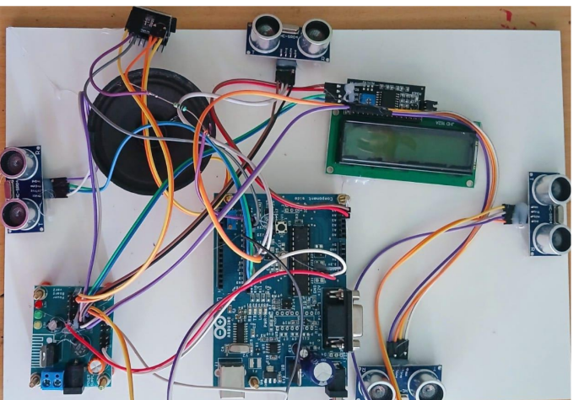
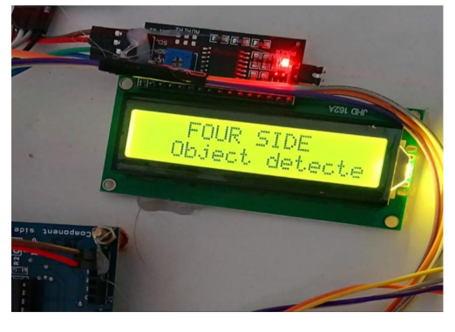
Output screenshot

Slide 22
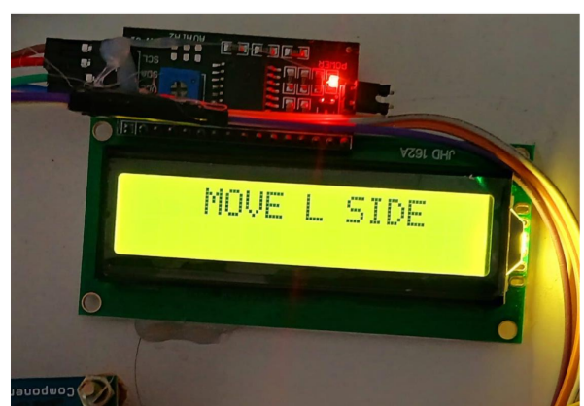
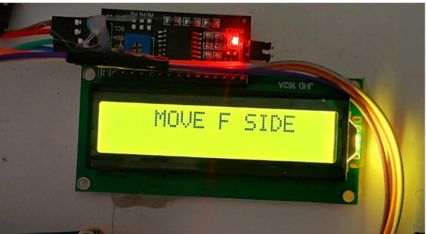
Output screenshot

Slide 23
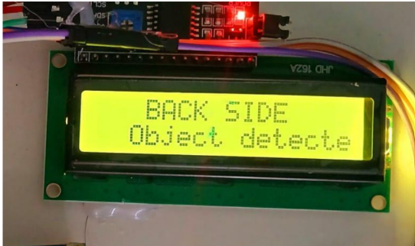
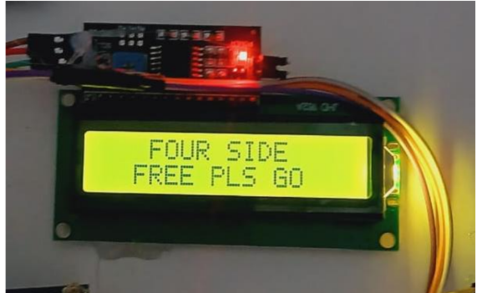
Output screenshot

Slide 24
Conclusion
The optimizing safety navigation aid for visually impaired is an innovative solution that enhances mobility and safety for visually impaired individuals. It uses an Arduino Uno and ultrasonic sensors to detect obstacles and guide users through real-time audio and buzzer alerts. The system offers clear and immediate feedback, helping users avoid collisions and navigate confidently. Its compact, wearable design ensures convenience for both indoor and outdoor use. Being affordable and easy to use, it is accessible to a wider community. The system also opens possibilities for future upgrades like GPS, IoT, and AI integration. Overall, it promotes independence, safety, and inclusivity in everyday life.

Slide 25
Future Enhancement
The Optimizing Safety Driven Navigation Aid for the Visually Impaired has significant potential for future enhancements to further improve its efficiency and user experience. One major enhancement could be the integration of GPS and Google Maps for outdoor navigation, enabling users to receive route directions and location-based guidance. Additionally, incorporating AI and machine learning algorithms can help predict the movement of dynamic obstacles, such as vehicles or pedestrians, and adjust guidance accordingly. The system can also be upgraded with Bluetooth or Wi-Fi connectivity to enable IoT-based remote monitoring, allowing caregivers to track the user's location and receive alerts in emergencies. Implementation of vibration motors for silent tactile feedback can offer a more discreet alert mechanism in noisy environments. Furthermore, designing the device with voice recognition capabilities could allow users to interact with the system through voice commands. These enhancements will make the system more intelligent, versatile, and user-friendly, expanding its real-world applications.

Slide 26
References
[1]Bourne, R. R., Flaxman, S. R., Braithwaite, T., Cicinelli, M. V., Das, A., Jonas, J. B., ... & Naidoo, K.(2017). Magnitude, temporal trends, and projections of the global prevalence of blindness anddistance and near vision impairment: a systematic review and meta-analysis. The Lancet Global Health, 5(9), e888-e897..
[2] The Financial Express. (2020). Visual impairment to increase dramatically: Study. Retrieved from https://thefinancialexpress.com.bd/health/visual-impairment to increase-dramatically-study-1579444915
[3] Wiener, W. R., Welsh, R. L., & Blasch, B. B. (2010). Foundations of orientation and mobility (Vol. 1). American Foundation for the BlindLinespacing: 1.0
[4] Wiener, W. R., Welsh, R. L., & Blasch, B. B. (2010). Foundations of orientation and mobility(Vol. 1). American Foundation for the Blind
[5] Jawale, R. V., Kadam, M. V., Gaikawad, R. S., & Kondaka, L. S. (2017, September). Ultrasonicnavigation based blind aid for the visually impaired. In 2017 IEEE International Conference onPower, Control, Signals and Instrumentation Engineering (ICPCSI) (pp. 923- 928). IEEE.

Slide 27
Thank you

